Slide 1
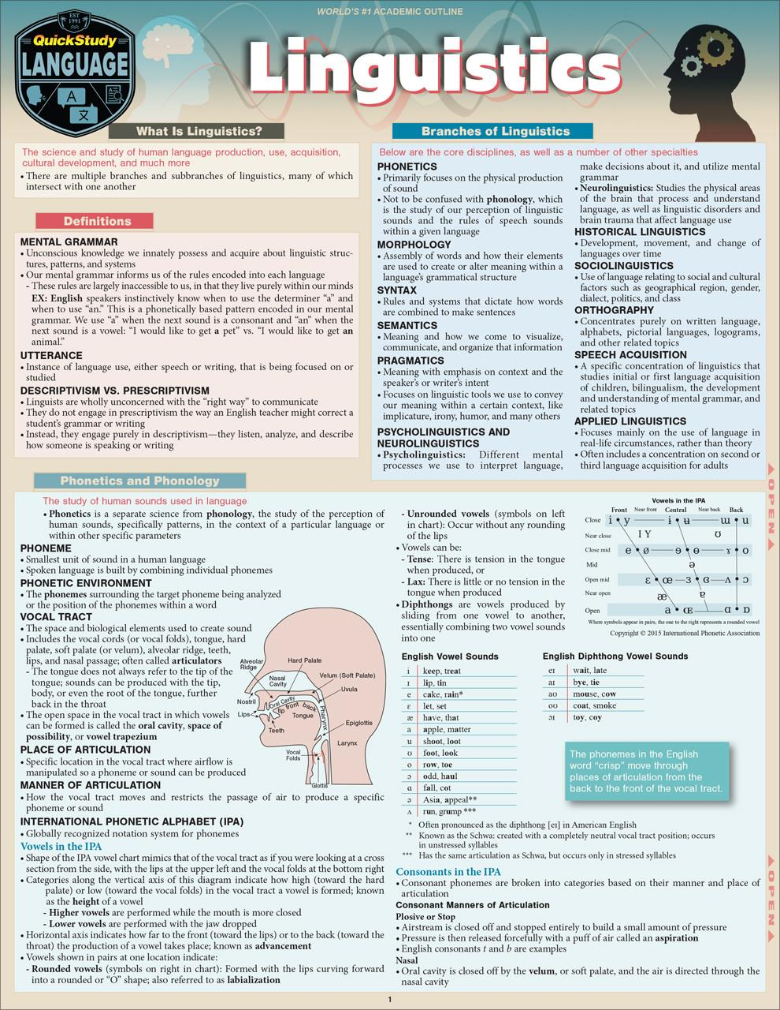
Introduction to Linguistics
Linguistics is the scientific study of language and its structure:
It encompasses various subfields that explore how language functions.
Understanding linguistics is crucial for grasping how humans communicate and convey meaning.
This discipline reveals insights into the cognitive processes behind language use.

Slide 2
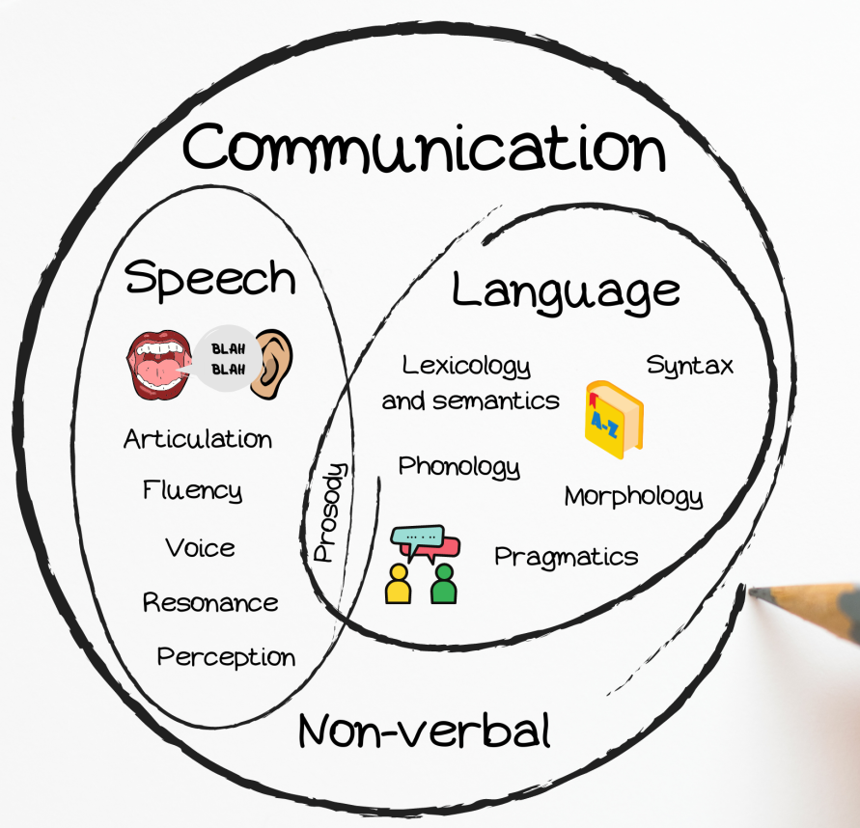
Language and Communication
Relationship Between Language and Communication:
Language serves as a tool for conveying meaning.
It facilitates interaction between individuals and groups.
Effective communication relies on shared linguistic codes and social contexts.

Slide 3
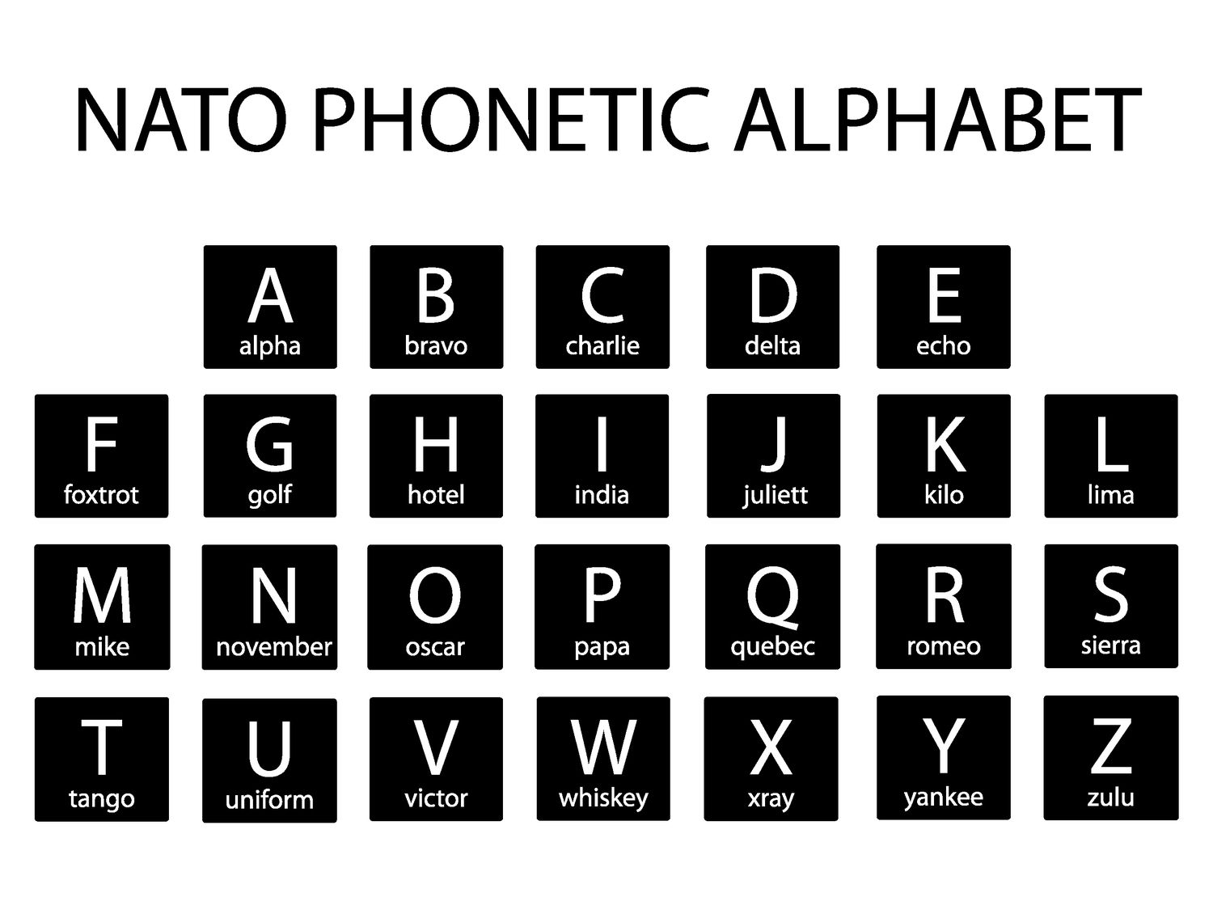
Phonetics and Phonology
Overview of Phonetics and Phonology:
Phonetics: The study of the physical sounds of human speech.
Phonology: Examines how sounds are organized and function in particular languages.
Understanding these areas helps in analyzing accents, dialects, and speech patterns.

Slide 4
Morphology
Structure of Words:
Morphology focuses on the internal structure of words.
Morphemes: The smallest units of meaning (e.g., prefixes, roots, suffixes).
Analyzing morphology reveals how words are formed and how they contribute to meaning.

Slide 5
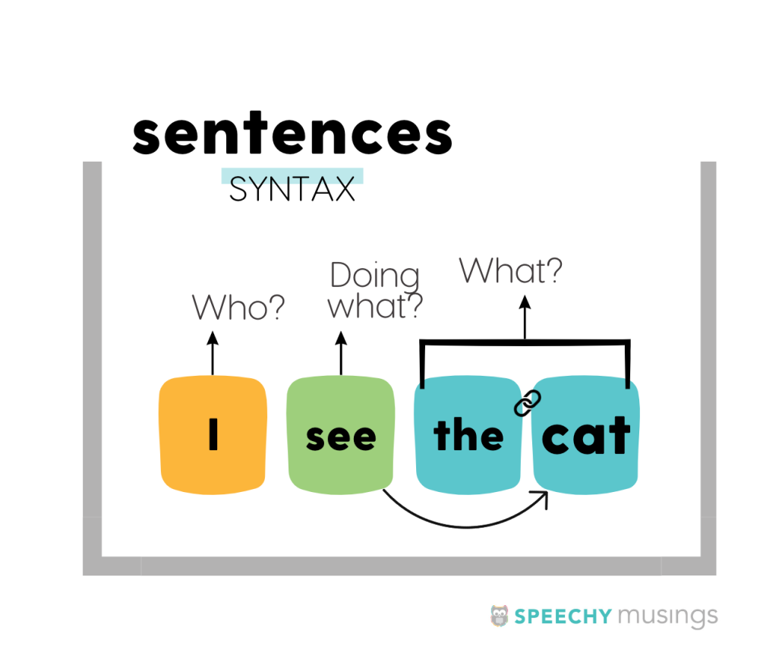
Syntax
Rules Governing Sentence Structure
Syntax studies how words combine to form phrases and sentences. It involves understanding the rules and principles that dictate word order. Syntax is essential for constructing grammatically correct sentences.

Slide 6

Semantics and Pragmatics
Meaning in Language:
Semantics: The study of meaning at the literal level.
Pragmatics: Focuses on meaning in context, considering factors like speaker intent and social cues.
Together, they provide a comprehensive understanding of how meaning is conveyed.

Slide 7



Sociolinguistics
Language Variation
Language and Identity
Analyzing Change
Sociolinguistics examines how language varies across different social groups.
It explores the relationship between language and identity, including factors like region, class, and ethnicity.
Understanding sociolinguistics helps in analyzing language change and social dynamics.

Slide 8
Historical Linguistics
Language Evolution
Methods of Study
Language Families
Historical linguistics studies how languages evolve over time.
It investigates language change through methods like comparative linguistics.
This field provides insights into language families and the historical connections between languages.

Slide 9

Psycholinguistics
Cognitive Processes in Language
Psycholinguistics explores the mental processes involved in language acquisition, comprehension, and production. It examines how individuals process language in real-time and how they learn languages. Understanding these processes is crucial for fields like education and cognitive science.

Slide 10
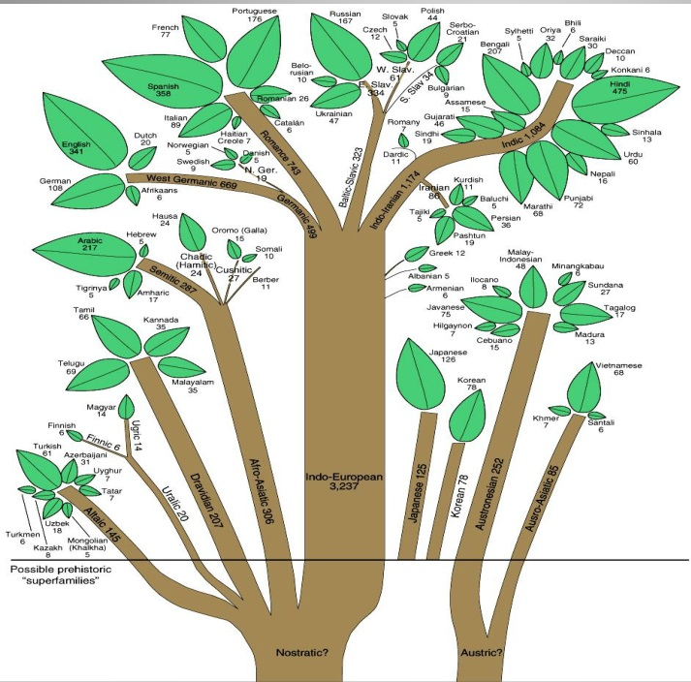
Typology and Universals
Classification of Languages:
Typology studies how languages can be classified based on their structural features.
Universals: Common characteristics shared across different languages.
This area of linguistics helps identify patterns and principles that govern all human languages.

Slide 11
Conclusion
Subfields of Linguistics
Holistic View
Importance of Study
Each area, from phonetics to sociolinguistics, contributes to a holistic view of language.
The study of linguistics is essential for grasping the complexities of human communication and interaction.
Linguistics encompasses various subfields that enhance our understanding of language.

